Slide 1

FAKE NEWS DETECTION
PRESENTED BY:
V VENKATA SREE HARSHA - 1NT18CS181

Slide 2
CONTENTS
Introduction
System Requirements
Definition of Fake News
Objective
Classification of Fake News
TFID Vectorizer
Passive Aggressive Classifier
Characterization To Detection
Feature Extraction
Datasets Used
Sample Dataset
Conclusion
References

Slide 3

INTRODUCTION
Now a days spreading of fake news is more because of social media and other platforms.
So Because of this there is a lot of misconception between real news and fake news
Fake news detection on social media has recently become an emerging research that is attracting tremendous attention

Slide 4
SYSTEM REQUIRMENTS
Windows 10 (or) More
Visual Studio Code With Python Installed
RAM: 4GB & ROM: 50Gb
Google Colab
Processor: Intel i5 (or) More
Live Server

Slide 5

DEFINATION OF FAKE NEWS
A type of yellow journalism, fake news encapsulates pieces of news that may be hoaxes and is generally spread through social media and other online media. This is often done to further or impose certain ideas and is often achieved with political agendas. Such news items may contain false and/or exaggerated claims, and may end up being viralized by algorithms, and users may end up in a filter bubble.

Slide 6
OBJECTIVE
To find whether the particular news is real news or fake news using TFIDF Vectorizer and Passive aggressive Classifier.

Slide 7
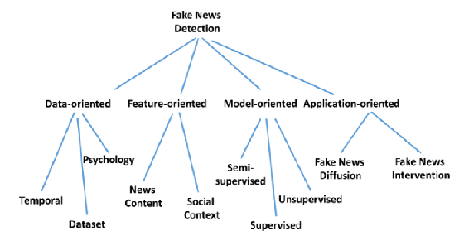
CLASSIFICATION OF FAKE NEWS

Slide 8
TFID VECTORIZER
TF (Term Frequency): The number of times a word appears in a document is its Term Frequency. A higher value means a term appears more often than others, and so, the document is a good match when the term is part of the search terms.
IDF (Inverse Document Frequency): Words that occur many times a document, but also occur many times in many others, may be irrelevant. IDF is a measure of how significant a term is in the entire corpus.
The Tfidf Vectorizer converts a collection of raw documents into a matrix of TF-IDF features.

Slide 9
PASSIVE AGGRESSIVE CLASSIFIER
Passive Aggressive algorithms are online learning algorithms. Such an
algorithm remains passive for a correct classification outcome, and turns
aggressive in the event of a miscalculation, updating and adjusting. Unlike most
other algorithms, it does not converge. Its purpose is to make updates that
correct the loss, causing very little change in the norm of the weight vector.

Slide 10
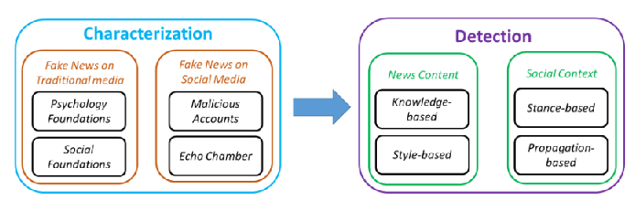
CHARACETRIZATION TO DETECTION

Slide 11
FEATURE EXTRACTION OF THE DATA SET
News Content Features
Linguistic-based
Visual-based
User-based
Post-based
Network-based

Slide 12
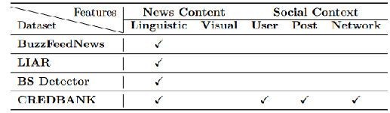
DATASETS USED
Datasets can be gathered in the following ways: Expert journalists, Fact-checking websites, Industry detectors, and Crowd-sourced workers. However, there are no agreed upon bench-mark datasets for the fake news detection problem. Some publicly available datasets are listed below:
Buzz Feed News
LIAR
BS Detector
CREDBANK

Slide 13

SAMPLE DATASET

Slide 14
CONCLUSION
With the increasing popularity of social media, more and more people consume news from social media instead of traditional news media. However, social media has also been used to spread fake news, which has strong negative impact son individual users and broader society. So with the help of this model we will be able to detect whether the particular news is real news (or) fake news.

Slide 15
REFERENCES
https://www.sciencedirect.com/science/article/pii/S1877050918318210
https://www.hindawi.com/journals/complexity/2020/8885861/
https://arxiv.org/pdf/1708.01967.pdf
https://www.geeksforgeeks.org/passive-aggressive-classifiers/
https://scikit-learn.org/stable/modules/generated/sklearn.feature_extraction.text.TfidfVectorizer.html

Slide 16
THANKYOU

